Slide 1
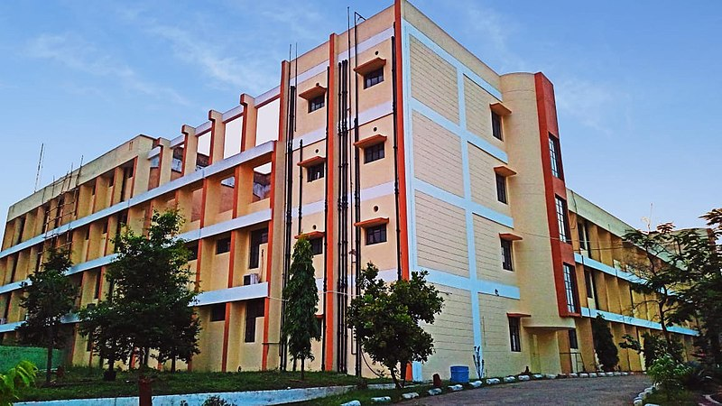

Slide 2


Ramgarh Engineering College
Department of Computer Science & Engineering
Group Project Presentation Title :
Cathode Ray tube
Presented by Group Roomies

Slide 3


Hello, classmates! We are Group Roomies!

Slide 4





Meet the Group Roomies

Slide 5
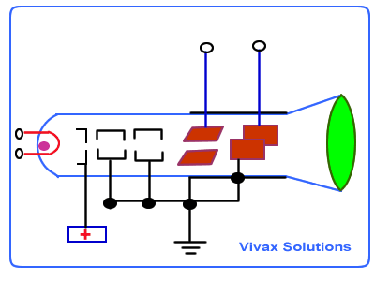
What is CRT?
A CRT is a vacuum tube containing an electron gun (a source of electrons) and a fluorescent screen, with internal or external means to accelerate and deflect the electron beam, used to create images in the form of light emitted from the fluorescent screen.

Slide 6

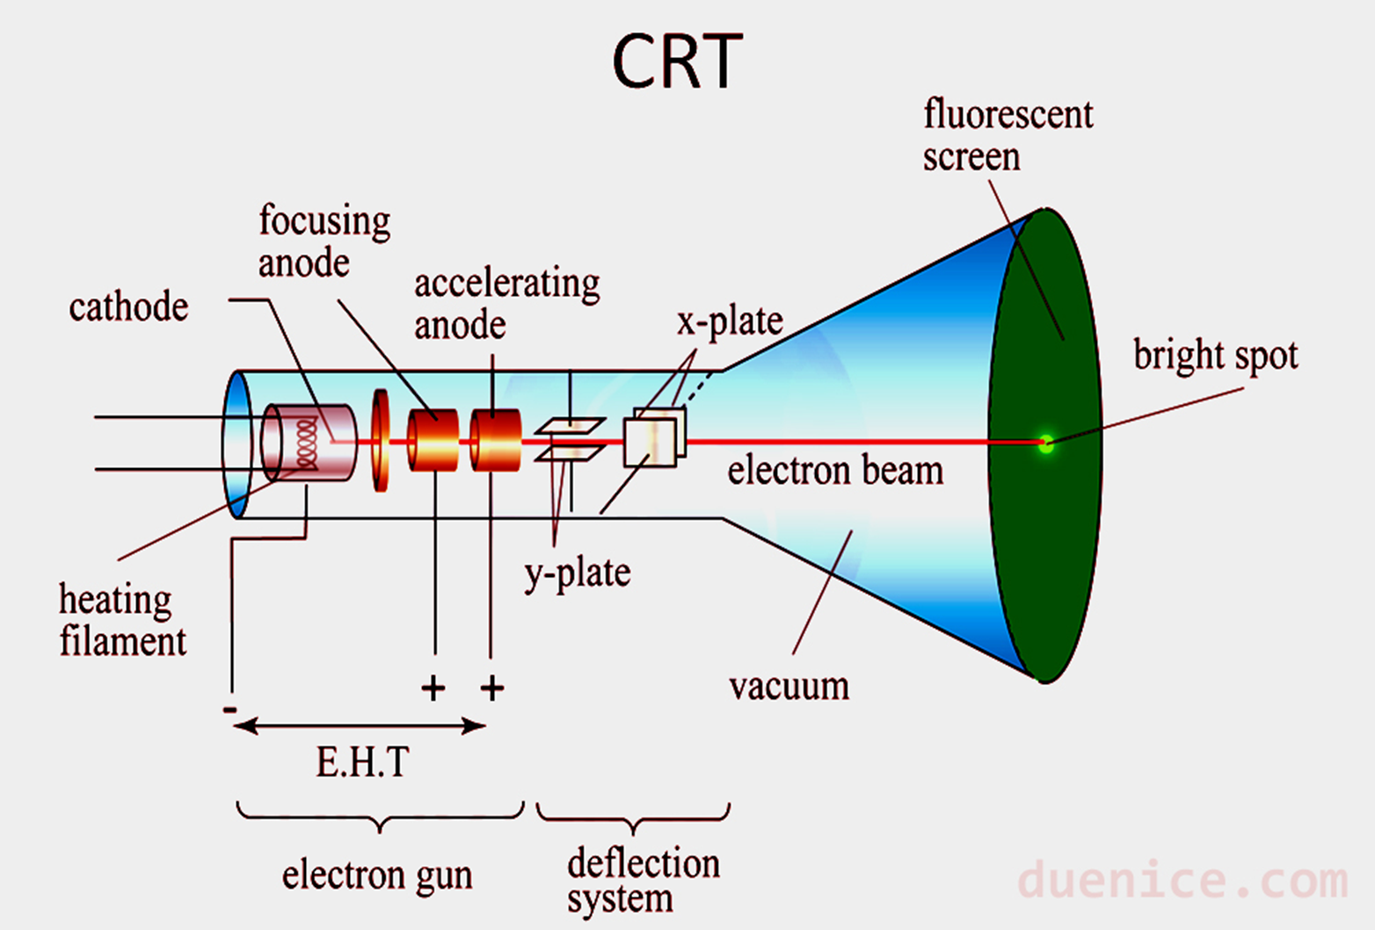

Slide 7
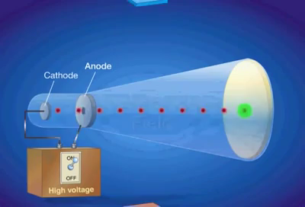
Principle behind Basic Working
The primary components of electron gun are heated metal cathode and control grid (which controls the intensity of electrons).
Heat is supplied to the filament and hence the electrons start boiling.
In the vacuum inside the monitor these electrons are accelerated (by the accelerating anode or by the positive metal coating near the phosphor screen) towards the phosphor coating by a high positive voltage.
Focusing system in CRT forces the electron beam to converge into a small spot as it strikes the phosphor.
Deflection of the electron beam can be controlled either by the electric field or by the magnetic field.

Slide 8
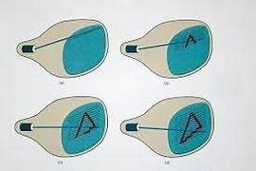
Random Scan Displays
When operated as random scan display unit, CRT has electron beam directed only to the parts of the screen where the picture is to be drawn.
These system are used for line drawing (produces smooth line drawings) applications and cannot display realistic shaded scenes.

Slide 9
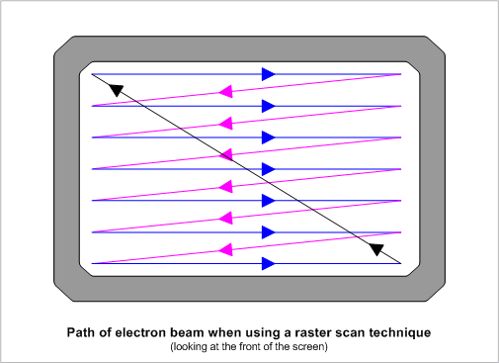
Raster Scan Display
Based on television technology , in these the electron beam sweeps across the screen one row at a time from top to bottom (scan lines swept by horizontal retrace and vertical retrace).
As the electron beam sweeps the intensity is turned on or off as per the picture definition stored in the frame buffer to create a pattern of illuminated spots.

Slide 10
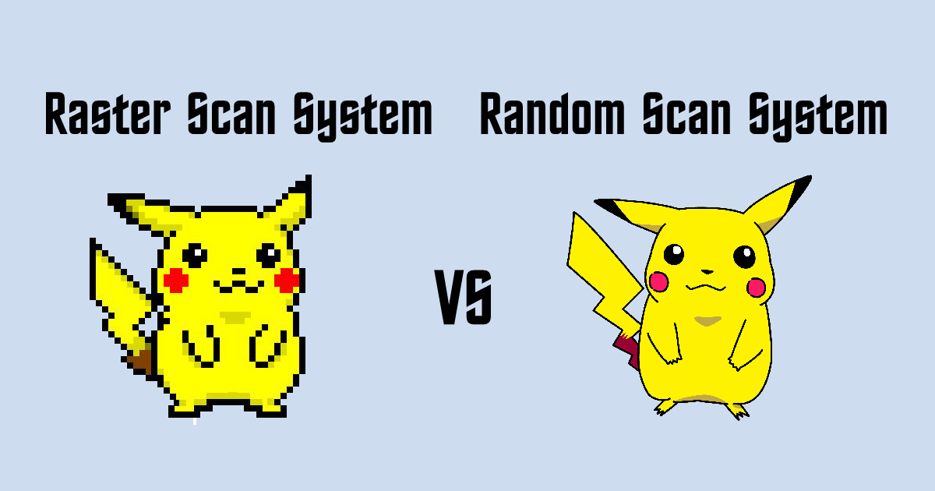

Slide 11
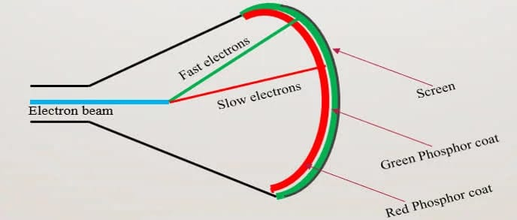
Beam Penetration Method
Used with random-scan monitors these systems have Two layers of phosphor, green the inner layer and red the outer one, are coated on to the inside of the CRT screen.
The displayed color depends on how far the electron beam penetrates into the phosphor layers.
It produces a limited number of colors red, orange, yellow and green.
Inexpensive way of producing colors in Random Scan
Picture Quality is not very good.

Slide 12
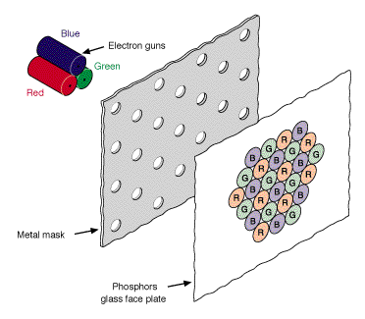
Shadow Mask Method
Commonly used in raster scan systems
It can display a much wider range than Beam Penetration Method
It has three phosphor color dots (red, green and blue) at each pixel position.
These systems have three electron guns. One for each color dot.
As per the picture definition the electron guns passes the electron beam which is properly deflected through the Shadow Mask hence forming a single beam.

Slide 13
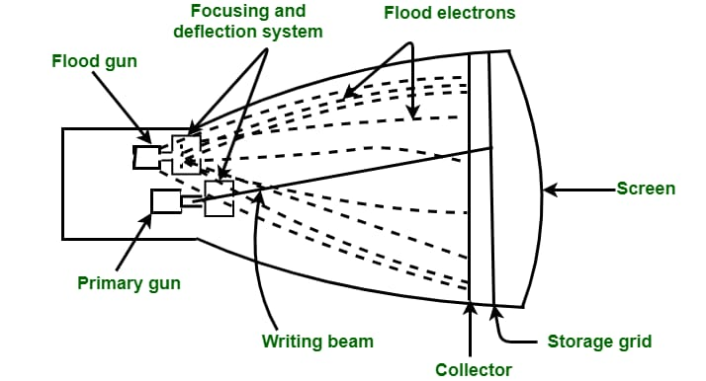
Direct View Storage Tube
In all the earlier technologies we need refreshing of the screen
An alternative method is Direct View Storage Tube .It stores the picture information as a charge distribution just behind the phosphor coated screen.
Two electron guns primary gun and flood gun are used
Primary gun stores the picture pattern and flood gun maintains the picture display

Slide 14
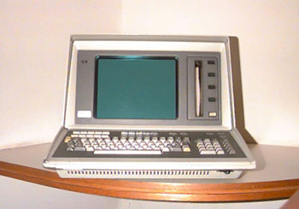
DVST Vs Refresh CRT
In DVST since no refreshing required so complex pictures can be displayed at higher resolution without flicker.
However DVST ordinarily does not display colors and parts of image cannot be erased here so not good for animation

Slide 15
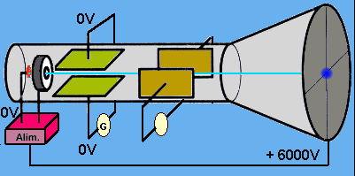
CRT Display : Advantages
They are quite cheaper than other monitors like LCD and LED.
These CRT monitors are quite responsive.
They are faster as they respond almost instantly average time interaction is less than 1 picosecond.
CRT monitors do not have native display resolution.
CRT monitors look equally good, particularly at any resolution.
They generally produce a dark black and heavy contrast level which is good for viewing in a dark environment.

Slide 16

CRT Display : Disadvantages
They are quite massive in size and need more space for installation.
CRT monitors emit heat and consume more energy than other monitors like LCD, and LED.
They do not work to their full potential while playing with graphics and resolutions.
They are less attractive compared to LCD and LED monitors.
They are not as bright as LCD monitors.

Slide 17

CRT in the Real World: Applications
CRTs are commonly used in television displays.
Fast-moving cathode rays that are suddenly stopped generate X-rays.
CRTs are used in cathode-ray oscilloscopes.
They are cost-effective.
CRTs have a fast response time and no motion blur.

Slide 18



THANK YOU!

